Slide 1
Final Project
Artificial Intelligence II
Artificial Intelligence II
Final Project
An STE-based methodology for constructing Bayesian Belief Networks
As applied to the prediction of Economic Indicators
Presented By
Fernando Torre
Lim Chanmann
Adil Al-Azzawi
Fernando Torre, Lim Chanmann, and Adil Al-Azzawi

Slide 2
Agenda
Introduction & Motivation
Problem Definition & Formulation
Related Works
Proposed Method & Implementation
Experimental Results
Conclusion

Slide 3
An STE-based methodology for constructing Bayesian Belief Networks
Final Project
Agenda
Introduction & Motivation
Problem Definition & Formulation
Related Works
Proposed Method & Implementation
Experimental Results
Conclusion

Slide 4
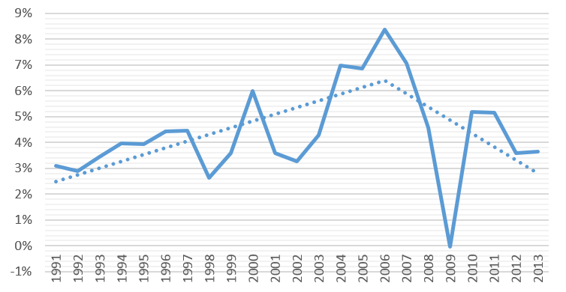
Motivation
An STE-based methodology for constructing Bayesian Belief Networks
Final Project
Economy
Percentage of growth in worldwide Gross Domestic Product per capita based on Purchasing Power Parity
Notes:
Economy is bad (worldwide. Since 2007)

Slide 5
Motivation
An STE-based methodology for constructing Bayesian Belief Networks
Final Project
Innovation
Education
Productive Knowledge
Economy
Industry
Notes:
We fucking know how to fix it

Slide 6
An STE-based methodology for constructing Bayesian Belief Networks
Final Project
Agenda
Introduction & Motivation
Problem Definition & Formulation
Related Works
Proposed Method & Implementation
Experimental Results
Conclusion

Slide 7

Task Environment
Indicators
State
Action
Education
College: 20%
Innovation
Journal Articles: 1%
Production
Industry: 33%
Agriculture: 40%
Region: South Asia
Predict economy
Goal
Prediction = actual value

Slide 8

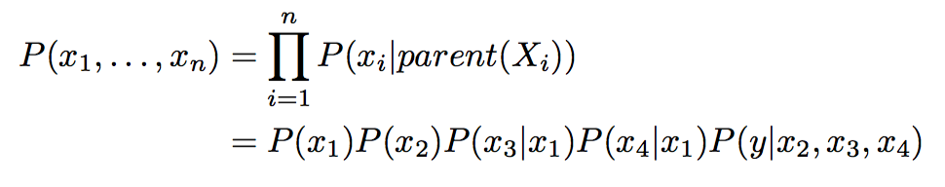
Problem Formulation
Model
Dependences
Domain Knowledge
X=<x1,x2,...,xn>, D={H,M,L}
Region1
x1
x2
x3
x4
P(X) = P(x1) . P(x2) . P(x3|x1) . P(x4|x1)
. P(y|x2, x3, x4)
x5

Slide 9
Problem model
Education Indicators
Innovation Indicators
Production Indicators
Economic Indicators

Slide 10
Meta-problem
’
Variables
Domain Knowledge

Slide 11

Problem Parameters
An STE-based methodology for constructing Bayesian Belief Networks
Final Project
Economic Indicators
Purchasing Power Parity (PPP)
GDP growth
Production indicators
Agriculture output
Industry output
Services output
Unemployment
Education
% Adults that went to college
% Adults that went to high school
Innovation indicators
Papers published
Trademark applications
Government incentives
Notes:
Economic

Slide 12
Problem Parameters for Network 1
An STE-based methodology for constructing Bayesian Belief Networks
Final Project
Economic Indicators
Purchasing Power Parity (PPP)
GDP growth
Production indicators
Agriculture output
Industry output
Services output
Unemployment
Education
% Adults that went to college
% Adults that went to high school
Innovation indicators
Papers published
Trademark applications
Government incentives

Slide 13
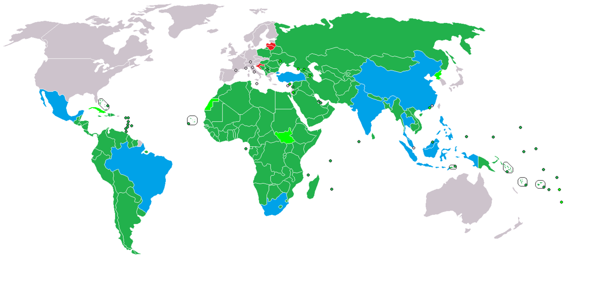

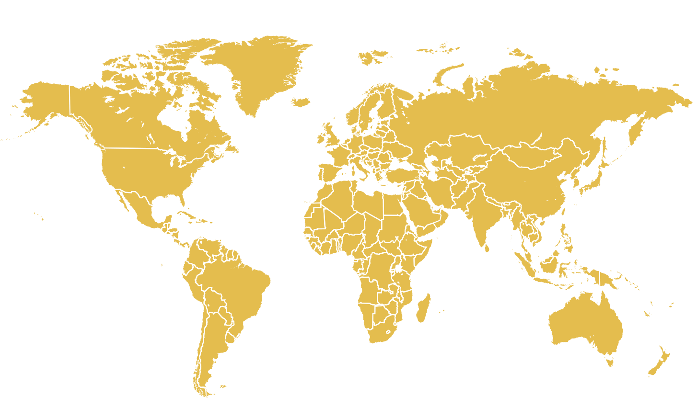
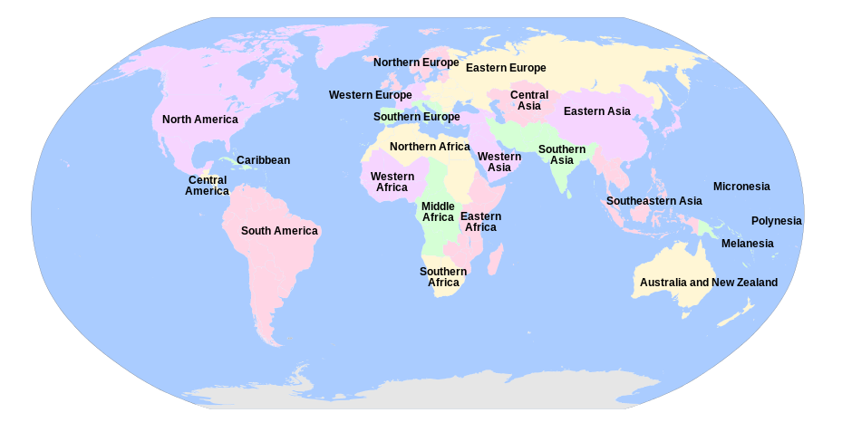
Diversity of Economic Environments
An STE-based methodology for constructing Bayesian Belief Networks
Final Project
■Developing ■Industrialized ■Developed
Development index (Wikimedia commons)
Official Subregions (United Nations)

Slide 14
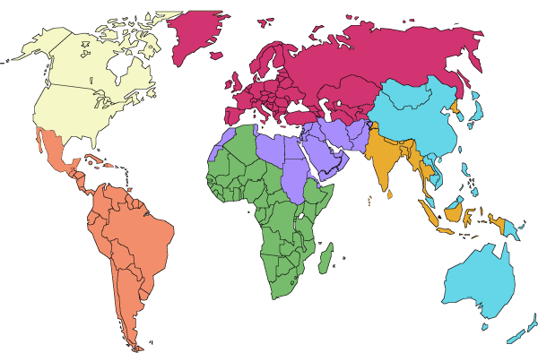
Regions
Final Project
Regions of the world (The World Bank)

Slide 15
An STE-based methodology for constructing Bayesian Belief Networks
Final Project
Agenda
Introduction & Motivation
Problem Definition & Formulation
Related Works
Proposed Method & Implementation
Experimental Results
Conclusion

Slide 16
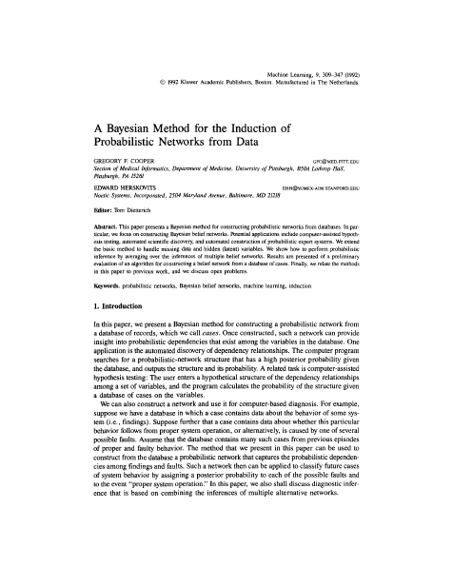
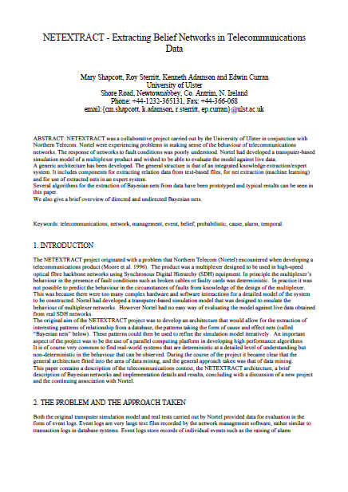
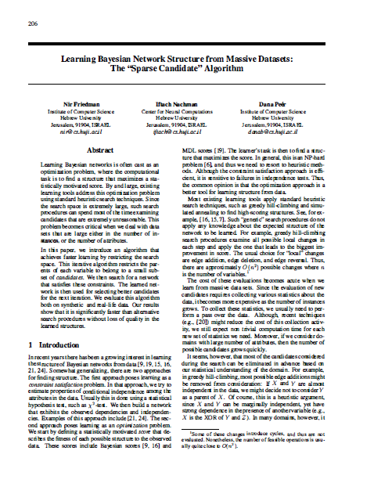
Bayesian Network Construction methodology
Final Project
Order dependent
Random initialization
Does not use domain knowledge
Notes:
Burglary alarm algorithm
Genetic algorithm
Algorithmic comparisons

Slide 17
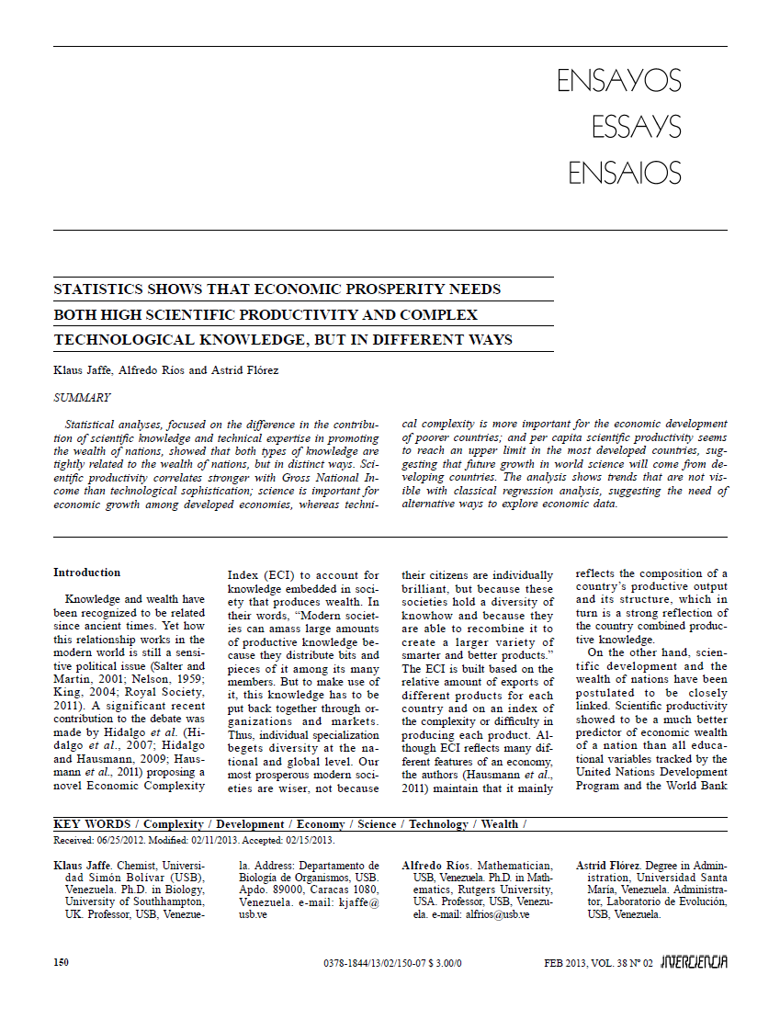
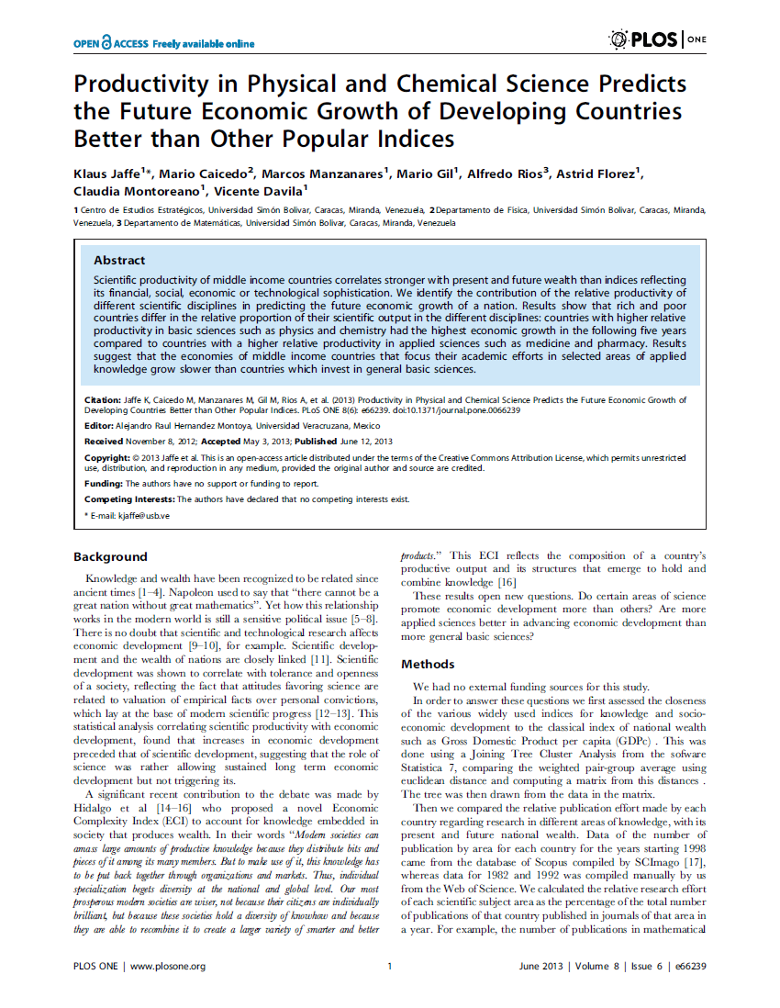


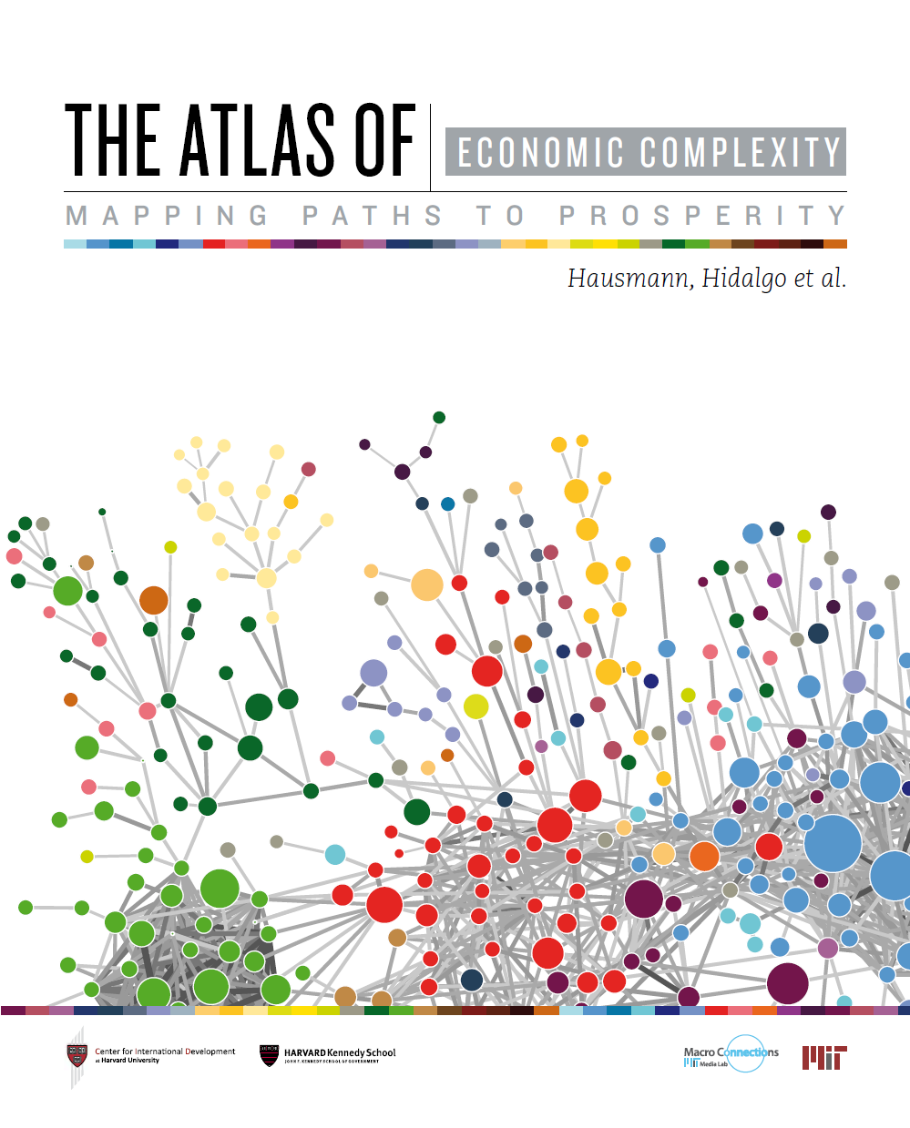
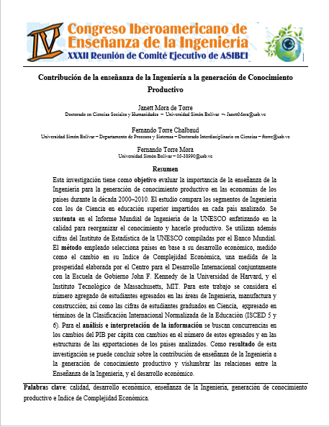

Influence of Economic Growth
Final Project
Notes:
Several papers in the area have proven the links in the data Books from reputable sources

Slide 18
An STE-based methodology for constructing Bayesian Belief Networks
Final Project
Agenda
Introduction & Motivation
Related Works
Problem Definition & Formulation
Proposed Method & Implementation
Experimental Results
Conclusion

Slide 19
Innovation
Start
Set of Parameters
STE formula
Dependency
Determination of Causality
Build the BN
Evaluate the BN
Find the Accuracy
End
Notes:
How we will build the bayesian net (using STE) is our actual contribution to the field

Slide 20
Method in the Problem Formulation frame
STE
Input
BN
Notes:
revsit black boxes

Slide 21
Implementation in Problem Formulation frame
Dataset
STE
Variable Dependences
Variable Dependences
BN
Domain Knowledge

Slide 22
Domain knowledge representation
An STE-based methodology for constructing Bayesian Belief Networks
Final Project
Basic Structure for BN#1
6
1
Education
Innovation
2
2
Production
1
Economic Indicators
2×6!=1440
2×(2+2)×2=16
Notes:
With 20 variables, we’d have to compare all against all:
compute 2 numbers for each -> Order 2*10^18 numbers
Divide into 5 groups, use domain knowledge to only do pairs of these 5 groups. Each group has about 4 variables to do all vs all with. Still 2 numbers per variable. Only about 240 numbers.

Slide 23
Domain knowledge representation
An STE-based methodology for constructing Bayesian Belief Networks
Final Project
Basic Structure for BN#2
11
2
3
Education
Innovation
Production
4
2
Economic Indicators
2×11!=79.8 Million
2×(2+3+2)×4+3×2=62
Notes:
Our method can also be used to represent more complex networks (WE WILL CALL THESE BN2

Slide 24
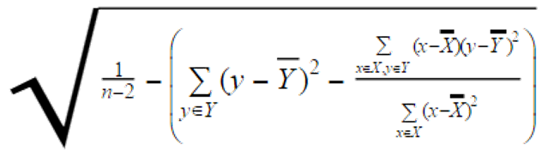
Dependence Analysis
An STE-based methodology for constructing Bayesian Belief Networks
Final Project
standard error for least-squares linear regression
STE
1−
Y
% Adults with College-level Education
Latin America
1996-2011
 | y:College alumni
x:College alumni
 |  | y:Industry
x:Industry
 |  | 95.7%
 | 76.0%
 | 100%
 |  | 100%
% output by Industry (minus costs)
Case A: x→y > y→x
Notes:
How to decide whether to add an arc (examples with real data)
if “forward” dependence > “backward” dependence, add the arc (“forward” given by domain knowledge)

Slide 25
Dependence Analysis
An STE-based methodology for constructing Bayesian Belief Networks
Final Project
STE
1−
Y
% from government incentives
South Asia
1990-2013
 | y:Government | y:GDP PPP
x:Government | 100% | 69.5%
x:GDP PPP | 95.5% | 100%
Gross Domestic Product per capita by Purchasing Power Parity
Case B: x→y ≪ y→x
Notes:
How to decide whether to add an arc (examples with real data)
if “forward” dependence MUCH LESS THAN “backward” dependence, discard the arc (contradicts domain knowledge)

Slide 26
Dependence Analysis
An STE-based methodology for constructing Bayesian Belief Networks
Final Project
STE
1−
Y
% output by Industry (minus costs)
 | y:Industry | y:GDP PPP
x:Industry | 100% | 95.2%
x:GDP PPP | 96.1% | 100%
Gross Domestic Product per capita by Purchasing Power Parity
Case C: x→y < y→x
~
threshold: 3%
Notes:
How to decide whether to add an arc (examples with real data)
if “forward” dependence SLIGHTLY LESS THAN “backward” dependence, add the arc (tolerance to errors/outliers in data) “slightly” given by threshold

Slide 27
Dependence Analysis
An STE-based methodology for constructing Bayesian Belief Networks
Final Project
STE
1−
Y
% Adults with High School Education
Dependence Analysis for South Asia
1994-2010
 | y:High School | y:Trademarks
x:High School | 100% | 45.2%
x:Trademarks | DK/DC | 100%
New Trademark Applications
Case D: x→y small
minimum: 60%
Notes:
How to decide whether to add an arc (examples with real data)
if “forward” dependence too small, discard without checking alternative. “too small” given by minimum

Slide 28
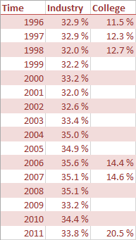
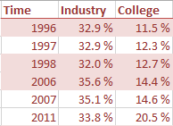
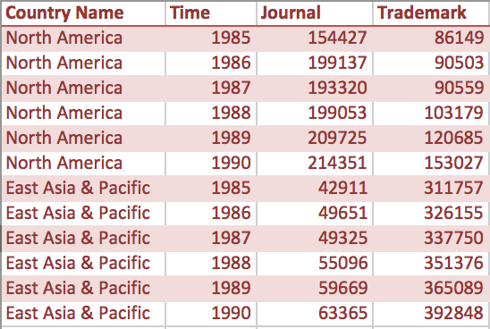
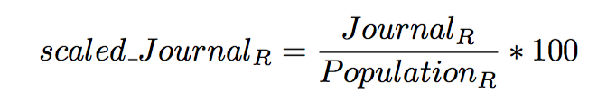
Missing values & scaling
Final Project
Latin America
1996-2011
Scale by Population
Notes:
Ignoring the missing data since fill in value or distribution to maximize the likelihood of the dataset of arbitrary selected subset of random variables will make it biased upon the selection.

Slide 29

Bayesian Network Construction
An STE-based methodology for constructing Bayesian Belief Networks
Final Project
Region Data
Variables Dependency table
Europe_STE_vals =
Education_to_var var_to_Education var_to_PPP PPP_to_var
________________ ________________ __________ __________
Agriculture 0.81713 0.88326 0.96397 0.93637
Industry 0.94811 0.86542 0.94017 0.96867
Government 0.96491 0.83388 0.88326 0.96941
Articles 0.94117 0.88830 0.94374 0.9537
Edu
Europe_STE_deps =
Education_to_var var_to_PPP
________________ __________
Agriculture false true
Industry true true
Government true false
Articles true true
Agr
Ind
jour
GDP PPP
Notes:
This is done automatically (BN networks implemented manually)

Slide 30
Bayesian Network Evaluation
Region Data
jour agr ind edu ppp
---- --- --- --- ---
M H H L L
M H H L L
M H M M L
M M M M
M L M M M
jour agr ind PPP=H PPP=M PPP=L
---- --- --- ----- ----- -----
H H H 0.33 0.33 0.33
H H M 0.33 0.33 0.33
H H L 0.33 0.33 0.33
H M H 0.33 0.33 0.33
H M M 0.33 0.33 0.33
H M L 0.33 0.33 0.33
H L H 0.33 0.33 0.33
H L M 0.33 0.33 0.33
H L L 0.50 0.25 0.25
M H H 0.14 0.14 0.71
M H M 0.25 0.25 0.50
M H L 0.33 0.33 0.33
M M H 0.33 0.33 0.33
M M M 0.08 0.83 0.08
M M L 0.33 0.33 0.33
M L H 0.33 0.33 0.33
M L M 0.50 0.33 0.17
M L L 0.40 0.40 0.20
L H H 0.33 0.33 0.33
L H M 0.33 0.33 0.33
L H L 0.33 0.33 0.33
L M H 0.33 0.33 0.33
L M M 0.33 0.33 0.33
L M L 0.33 0.33 0.33
L L H 0.33 0.33 0.33
L L M 0.33 0.33 0.33
L L L 0.33 0.33 0.33
1994
1995
1996
1997
1998
...
Edu
Maximum likelihood Estimation with Laplacian Smoothing (k = 1)
Agr
Ind
jour
GDP PPP
Notes:
Discretize data -> MLE -> CPT

Slide 31
Bayesian Network Evaluation
jour agr ind PPP=H PPP=M PPP=L
---- --- --- ----- ----- -----
H H H 0.33 0.33 0.33
H H M 0.33 0.33 0.33
H H L 0.33 0.33 0.33
H M H 0.33 0.33 0.33
H M M 0.33 0.33 0.33
H M L 0.33 0.33 0.33
H L H 0.33 0.33 0.33
H L M 0.33 0.33 0.33
H L L 0.50 0.25 0.25
M H H 0.14 0.14 0.71
M H M 0.25 0.25 0.50
M H L 0.33 0.33 0.33
M M H 0.33 0.33 0.33
M M M 0.08 0.83 0.08
M M L 0.33 0.33 0.33
M L H 0.33 0.33 0.33
M L M 0.50 0.33 0.17
M L L 0.40 0.40 0.20
L H H 0.33 0.33 0.33
L H M 0.33 0.33 0.33
L H L 0.33 0.33 0.33
L M H 0.33 0.33 0.33
L M M 0.33 0.33 0.33
L M L 0.33 0.33 0.33
L L H 0.33 0.33 0.33
L L M 0.33 0.33 0.33
L L L 0.33 0.33 0.33
Enumeration / Elimination
Prediction
P(PPP|Evidences)
Notes:
Once we have CPT, we can proceed normally

Slide 32
An STE-based methodology for constructing Bayesian Belief Networks
Final Project
Agenda
Introduction & Motivation
Related Works
Problem Definition & Formulation
Proposed Method & Implementation
Experimental Results
Conclusion

Slide 33
An STE-based methodology for constructing Bayesian Belief Networks
Final Project
Results
STE to construct BN1 and BN2
Constructed BN1
Constructed BN2
Accuracy for Baseline & BN1

Slide 34
Bayesian Network Structures
Baise Line Structure:
An STE-based methodology for constructing Bayesian Belief Networks
Final Project
College
Agriculture
Industry
Goverment
spending
Journal Article
PPP
Notes:
that because the Education doesn’t have a related connection with the other parameters so it doesn’t describe the true relationship between all the parameters

Slide 35
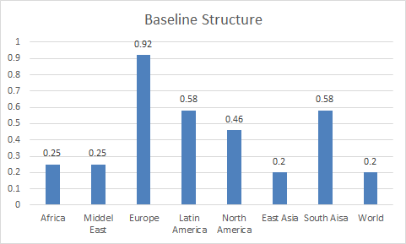
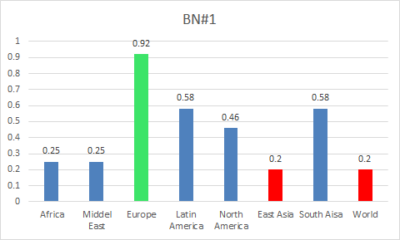
Baseline Accuracy & Performance
Baseline Structure:
Accuracy
Africa
Middle East
Europe
Latin America
North America
East Asia
South Asia
World
An STE-based methodology for constructing Bayesian Belief Networks
Final Project
0.25
0.25
0.92
0.92
0.58
0.46
0.20
0.20
0.58
0.20
0.20

Slide 36
Bayesian Network #1 Structures & Accuracy
Africa Region
Accuracy
Baseline
An STE-based methodology for constructing Bayesian Belief Networks
Final Project
0.67
Agriculture
Journal
&
Articles
0.25
PPP

Slide 37
Bayesian Network #1 Structures & Accuracy
Middle East Region
Accuracy
Baseline
An STE-based methodology for constructing Bayesian Belief Networks
Final Project
0.75
Agriculture
Industry
Goverment
Journal
&
Articles
0.25
PPP

Slide 38
Bayesian Network #1 Structures & Accuracy
Europe Region
Accuracy
Baseline
An STE-based methodology for constructing Bayesian Belief Networks
Final Project
College
0.792
Agriculture
Industry
Journal
&
Articles
0.92
PPP

Slide 39
Bayesian Network #1 Structures & Accuracy
Latin America Region
Accuracy
Baseline
An STE-based methodology for constructing Bayesian Belief Networks
College
0.71
Agriculture
Journal
&
Articles
0.58
PPP

Slide 40
Bayesian Network #1 Structures & Accuracy
North America Region
Accuracy
Baseline
An STE-based methodology for constructing Bayesian Belief Networks
College
0.54
Agriculture
Journal
&
Articles
0.46
PPP

Slide 41
Bayesian Network #1 Structures & Accuracy
South Asia Region
Accuracy
Baseline
An STE-based methodology for constructing Bayesian Belief Networks
Final Project
0.65
College
Journal
&
Articles
0.58
PPP

Slide 42
Bayesian Network #1 Structures & Accuracy
East Asia Region
Accuracy
Baseline
An STE-based methodology for constructing Bayesian Belief Networks
Final Project
0.67
Agriculture
Journal
&
Articles
PPP
0.20

Slide 43
Bayesian Network #1 Structures & Accuracy
World
Accuracy
Baseline
An STE-based methodology for constructing Bayesian Belief Networks
Final Project
0.55
Agriculture
PPP
0.20

Slide 44
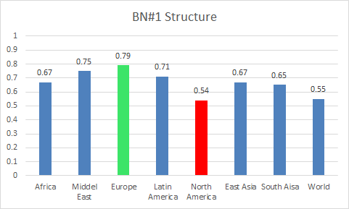
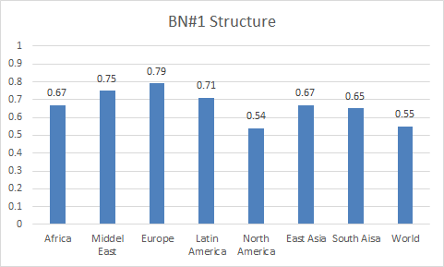
Bayesian Network#1
Accuracy
Africa
Middle East
Europe
Latin America
North America
East Asia
South Asia
World
An STE-based methodology for constructing Bayesian Belief Networks
Final Project
Bayesian Network #1 Performance
0.67
0.75
0.79
0.79
0.71
0.54
0.54
0.67
0.65
0.55

Slide 45
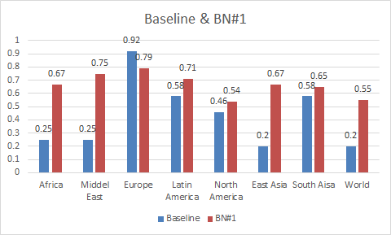
Baseline & BN#1 Performance Results
An STE-based methodology for constructing Bayesian Belief Networks
Final Project

Slide 46
Bayesian Network# 2 Structures
Africa Region
Middle East Region
East Asia
World
An STE-based methodology for constructing Bayesian Belief Networks
Final Project
An STE-based methodology for constructing Bayesian Belief Networks
gov
Jou
gov
Jou
TM
Agr
Agr
Ind
PPP
PPP
Jou
TM
Agr
Agr
PPP
PPP
Notes:
Diverse economic environments:
(If we use the data from other countries to predict another country economy, it might not be accurate as each country economic environment is different)
Scarcity of data
(If we pick the data from each country to predict its own economy, the data will be inadequate)
Gaussian assumption
Problem of Induction
(If method fails, it only fails with this one particular problem)
Nonsense links

Slide 47
Bayesian Network# 2 Structures
Europe Region
Latin America Region
North America Region
An STE-based methodology for constructing Bayesian Belief Networks
Final Project
Coll
HS
HS
TM
gov
Jou
Ter
TM
Jou
Agr
Ind
Agr
unp
PPP
Coll
HS
PPP
TM
gov
Jou
Agr
Ind
unp
PPP

Slide 48
An STE-based methodology for constructing Bayesian Belief Networks
Final Project
Agenda
Introduction & Motivation
Related Works
Problem Definition & Formulation
Proposed Method & Implementation
Experimental Results
Conclusion

Slide 49
Conclusions
An STE-based methodology for constructing Bayesian Belief Networks
Final Project
Successes
Challenges
Accuracy improvement
Non-Europe
Baseline: 20–58%
BN1 model: 54–75%
Europe
Baseline: 92%
BN1 model: 79%
Domain-independent (BN2)
Could not predict
GDP growth % (all regions, BN 1 & 2)
STE could not find relation with other variables
PPP (South Asia, BN2)
Notes:
GDP growth % is the difference from previous year
but other variables measure only the current year

Slide 50
Conclusion
Future work
Aggregate countries differently
Reduce missing data
Select more variables
Automate BN generation
Evaluate other queries
Evaluate thresholds tuning
Include temporal aspect (time slices)
Notes:
Treat missing values differently (E-M estimation? Laplacian k>1?)

Slide 51
References
An STE-based methodology for constructing Bayesian Belief Networks
Final Project
Hausmann, R., Hidalgo, C., Bustos, S., Coscia, M., Chung, S., Jiménez, J. S.,Simoes, A., and Yıldırım, M.. (2011). The Atlas of Economic Complexity - Mapping paths of prosperity. Boston: Center for International Development - Harvard University.
Shapcott, M., Sterritt, R., Adamson, K., and Curran, E. (1999) “NETEXTRACT - Extracting Belief Networks in Telecommunications Data.” The Pennsylvania State University. http://citeseerx.ist.psu.edu/viewdoc/summary?doi=10.1.1.28.6865.
UNESCO. (2010). Engineering: Issues, Challenges and Opportunities for Development UNESCO Report. Unesco. http://unesdoc.unesco.org/images/0018/001897/189753e.pdf.
World Bank. (2015) World Bank Open Data. World Bank Group. http://data.worldbank.org.
Zady, M. “Correlation and Simple Least Squares Regression” (Aug 2000) Westgard QC. https://www.westgard.com/lesson42.htm.
Bokova, I in UNESCO. (2010). “Foreword.” Engineering: Issues, Challenges and Opportunities for Development UNESCO Report. http://unesdoc.unesco.org/images/0018/001897/189753e.pdf .
Chickering, D. and D. Heckerman. (Jul 31 1997) “Scalable Methods for Learning Bayesian Networks”. Microsoft Corporation (assignee). Patent 7,251,636. http://patentimages.storage.googleapis.com/pdfs/US7251636.pdf

Slide 52
References
An STE-based methodology for constructing Bayesian Belief Networks
Final Project
Cooper, G. and Herskovits, E. (Oct 1992) “A Bayesian Method for the Induction of Probabilistic Networks from Data.” Machine Learning. Volume 9, Issue 4, pp 309-347. Springer International. http://link.springer.com/article/10.1007%2FBF00994110
Drahokoupil, J. “Investment incentive.” (May 30 2013) Encyclopædia Britannica Online. Encyclopædia Britannica Inc, http://www.britannica.com/EBchecked/topic/1929166/investment-incentive.
Friedman, N., Nachman, I., Peér, D., (1999) “Learning of Bayesian Network Structure from Massive Datasets: The ‘Sparse Candidate’ Algorithm.” UAI'99 Proceedings of the Fifteenth conference on Uncertainty in artificial intelligence, pp 206-215. http://dl.acm.org/citation.cfm?id=2073820.
Helman, P., Veroff, R., Atlas, S., and Willman, C. (January 20, 2005) “A Bayesian Network Classification Methodology for Gene Expression Data.” Journal of Computational Biology, Vol. 11, Issue 4. http://online.liebertpub.com/doi/abs/10.1089/cmb.2004.11.581 .
Sangram Singh, et al. "What is the difference between the manufacturing sector and the industrial sector?" Quora. http://www.quora.com/What-is-the-difference-between-the-manufacturing-sector-and-the-industrial-sector.

Slide 53
References
An STE-based methodology for constructing Bayesian Belief Networks
Final Project
"Unemployment, total (% of total labor force) (national estimate)." The World Bank. http: // data. worldbank.org/indicator/SL.UEM.TOTL.NE.ZS.
"Main statistics (annual) - Unemployment" _LABORSTA Internet_ http: // laborsta.ilo.org /applv8 /data /c3e.html.
“Indicator 8: Educational Attainment of the Youth Labour Force." _Youth Labour Market Indicators_. Youth Employment Network. http://www.ilo.org/public/english/employment/yen/whatwedo/projects/indicators/8.html.

Slide 54

Thank You

